Slide 1

Java DataOutputStream class
The Java DataOutputStream class enables you to write Java primitives to OutputStream's instead of only bytes.
We can wrap an OutputStream in a DataOutputStream and then we can write primitives to it. That is why it is called a DataOutputStream - because we can write int, long, float and double values to theOutputStream, and not just raw bytes.
Often you will use the Java DataOutputStream together with a Java DataInputStream. You use the DataOutputStream to write the data to e.g. a file, and then use the DataInputStream to read the data again.
A DataOutputStream lets an application write primitive Java data types to an output stream in a portable way. An application can then use a DataInputStream to read the data back in.
PrintStream
OutputStream(i.e FileOutputStream)
DataOutputStream
Java Application
Write
Write

Slide 2
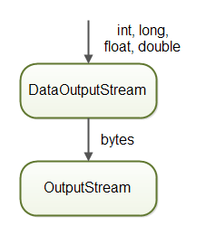
Java DataOutputStream class

Slide 3
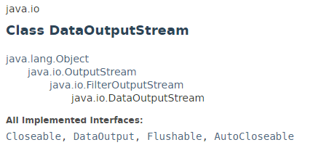

Java DataOutputStream class

Slide 4
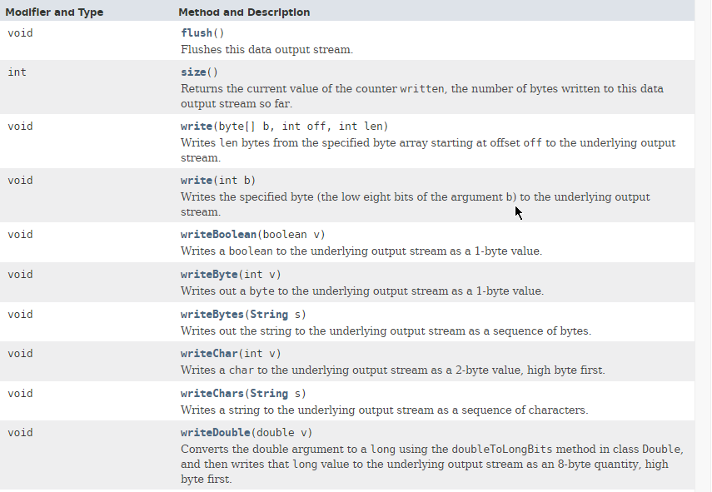
Java DataOutputStream class

Slide 5
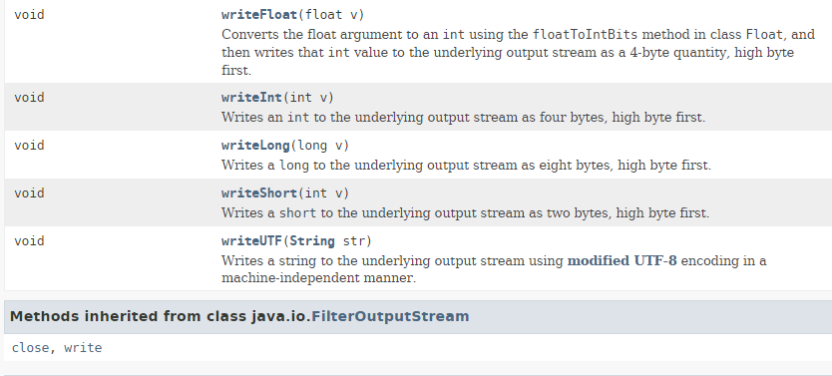
Java DataOutputStream class

Slide 6
Java DataOutputStream class
https://docs.oracle.com/javase/8/docs/api/index.html?java/io/DataOutputStream.html

